Slide 1
Biol 7200: Programming for Bioinformatics Plotting and statistics in Python

Slide 2
Plan for today
What is a plot?
Guidelines for creating effective plots
Plotting in Python
Intro to statistics
Statistics in Python

Slide 3
Plan for today
What is a plot?
Guidelines for creating effective plots
Plotting in Python
Intro to statistics
Statistics in Python

Slide 4
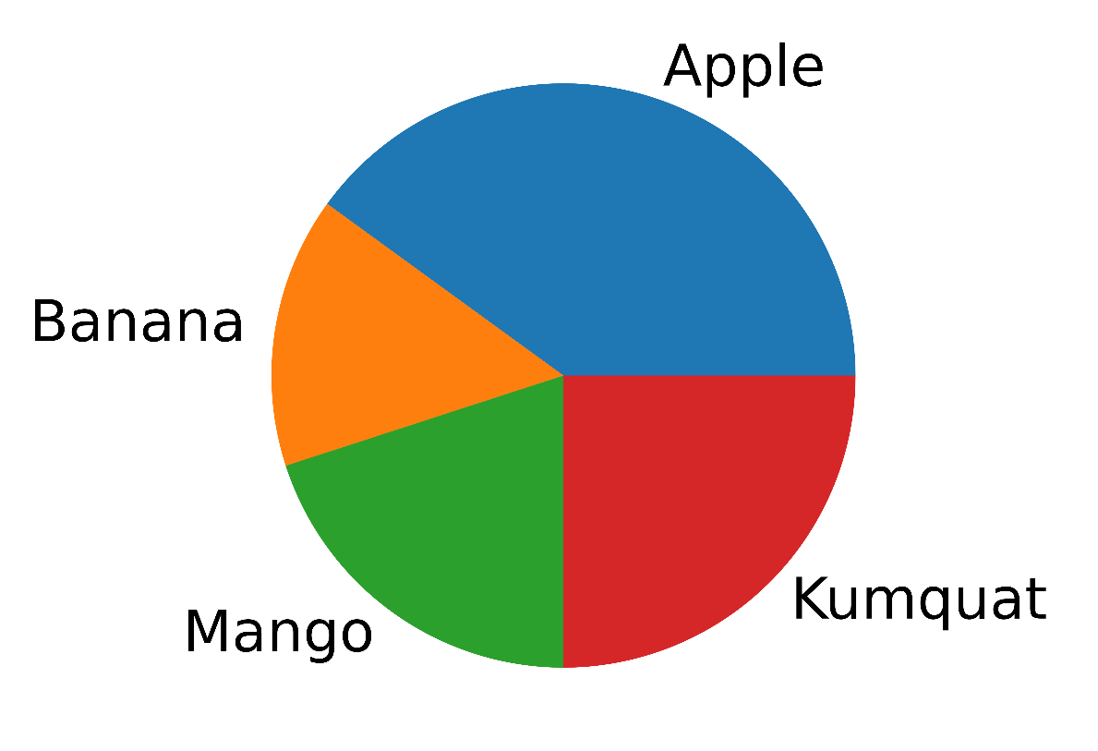
A plot is a visual representation of data
I have 80 apples, 30 bananas, 40 mangos, and 50 kumquats.
Apples | Bananas | Mangos | Kumquats
80 | 30 | 40 | 50

Slide 5
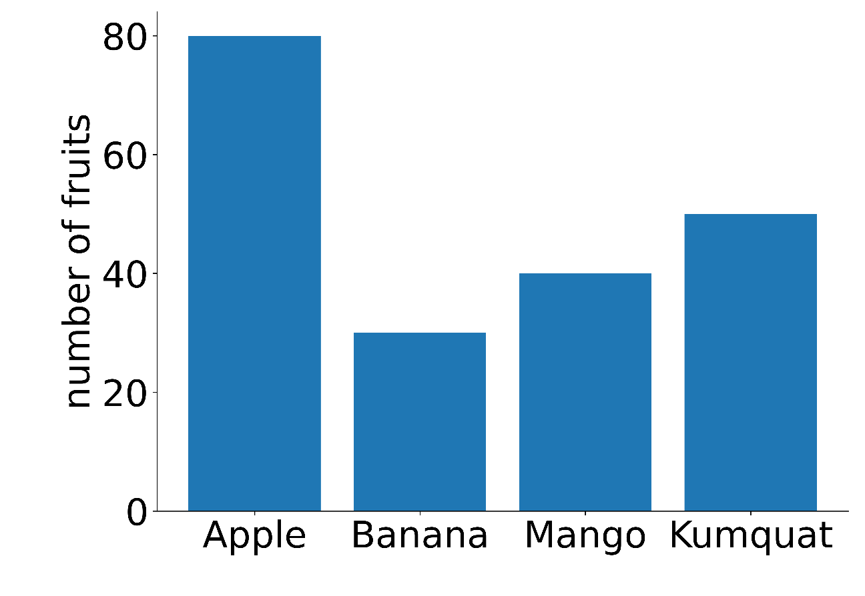
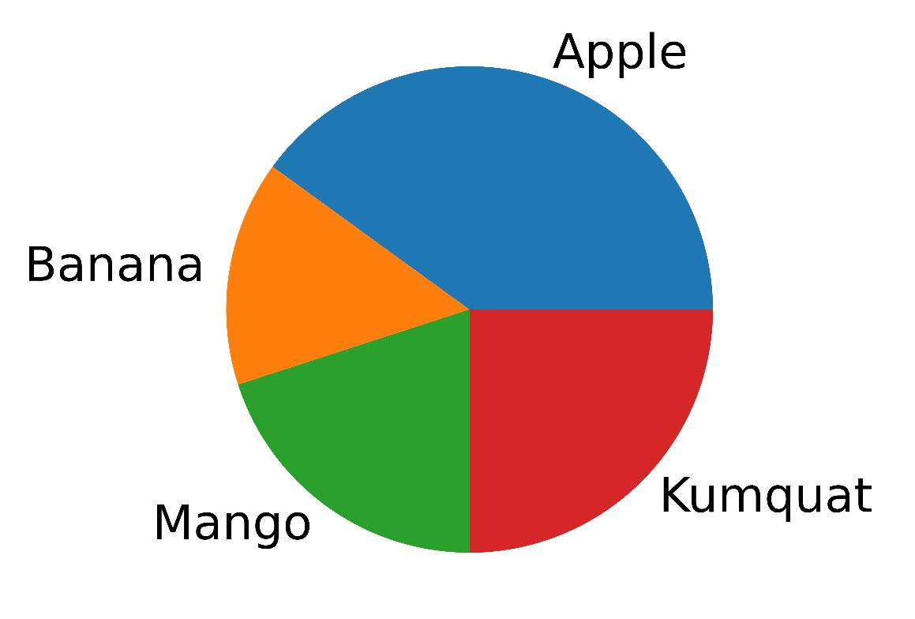
Plots can communicate data differently
I have 80 apples, 30 bananas, 40 mangos, and 50 kumquats.
Of my fruits, 40% are apples, 15% bananas, 20% mangos, and 25% kumquats

Slide 6
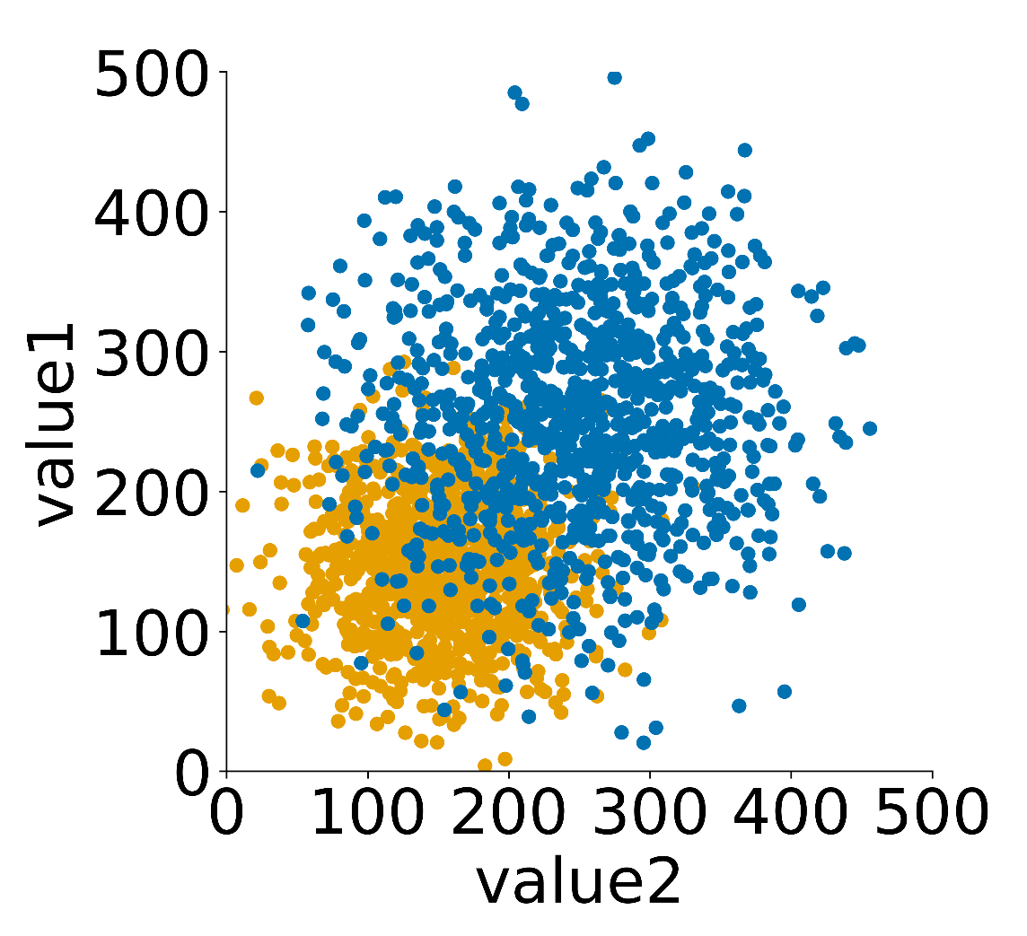
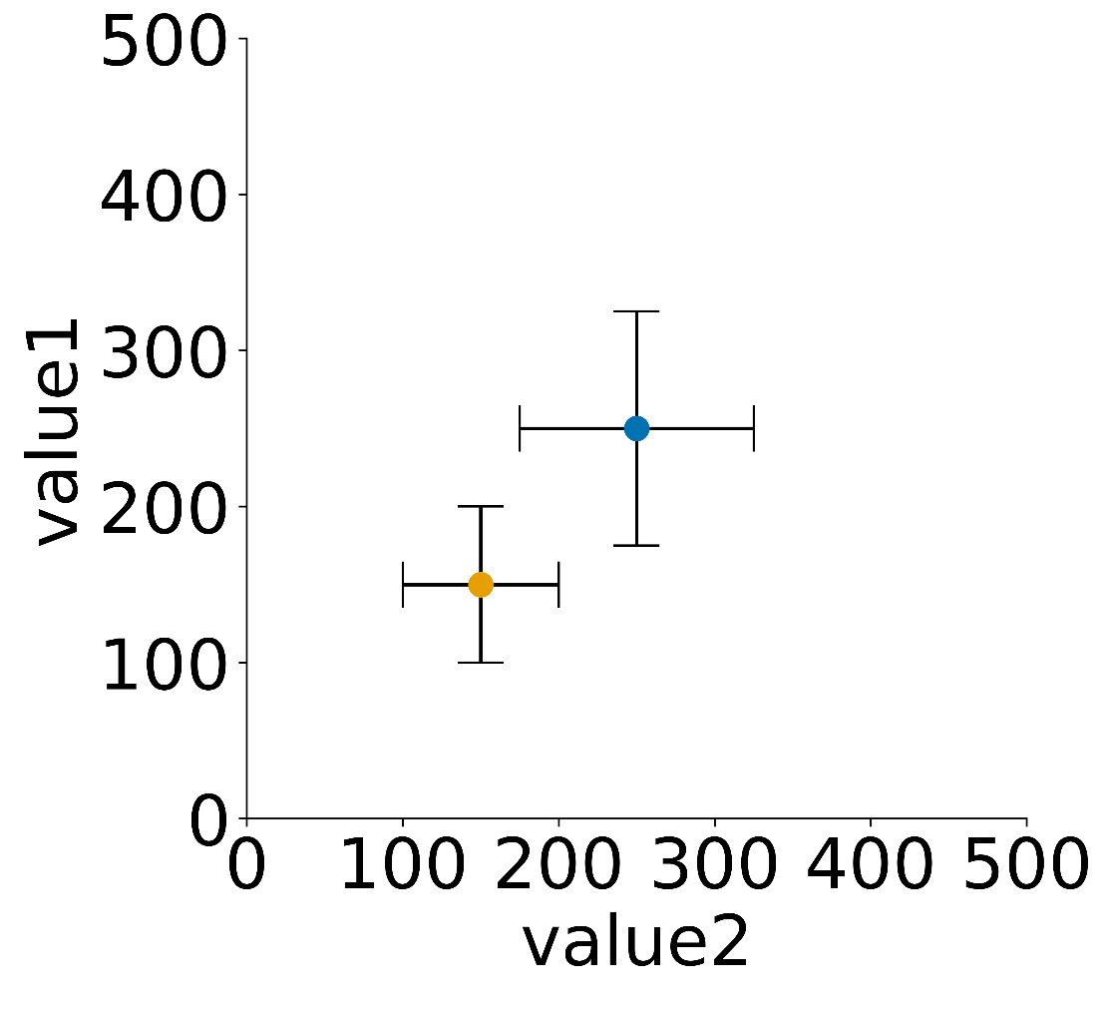
Plots can be complex or simple

Slide 7
Plan for today
What is a plot?
Guidelines for creating effective plots
Plotting in Python
Intro to statistics
Statistics in Python

Slide 8
What makes an effective plot?
Plots are a method of communication
Good communication conveys the desired message clearly
Therefore, a good plot is one that communicates its message clearly
Anything that improves the clarity of the message, improves the plot

Slide 9
Things to consider when designing a plot
What is the question?
E.g., exploring data or trying to visualize a specific difference
Who is the audience?
Yourself, your lab, readers of your paper, oral presentation audience
Is there a specific message?
If not what are you showing the plot for?
Can any elements be removed from the plot?
Often less is clearer. E.g., can you remove color, use of shapes or patterns, use of size?
Do you need to plot every sample?
If you are trying to show a comparison between two, maybe don’t plot the rest.

Slide 10
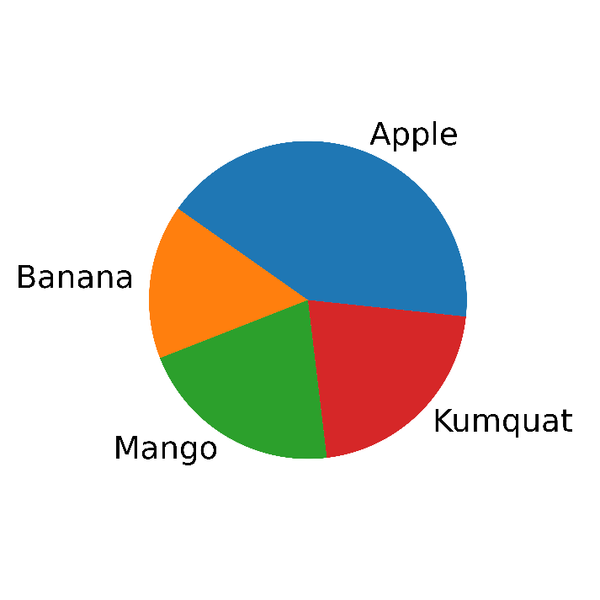
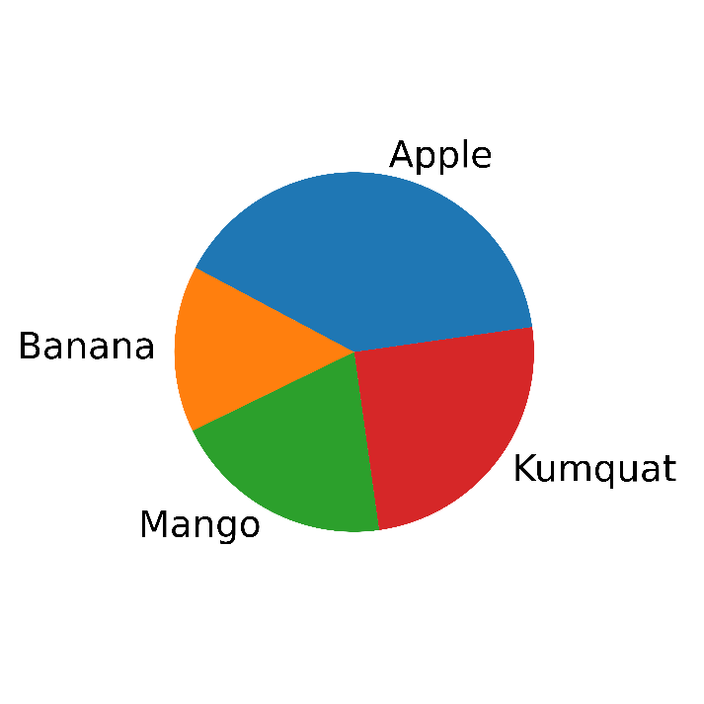
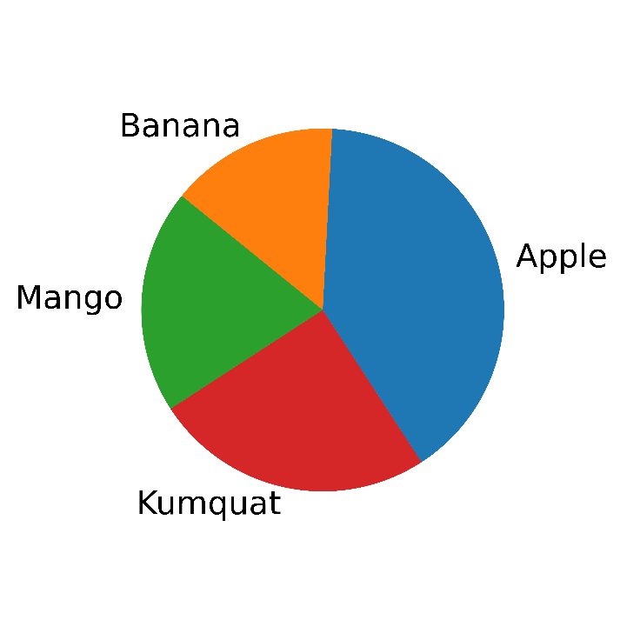
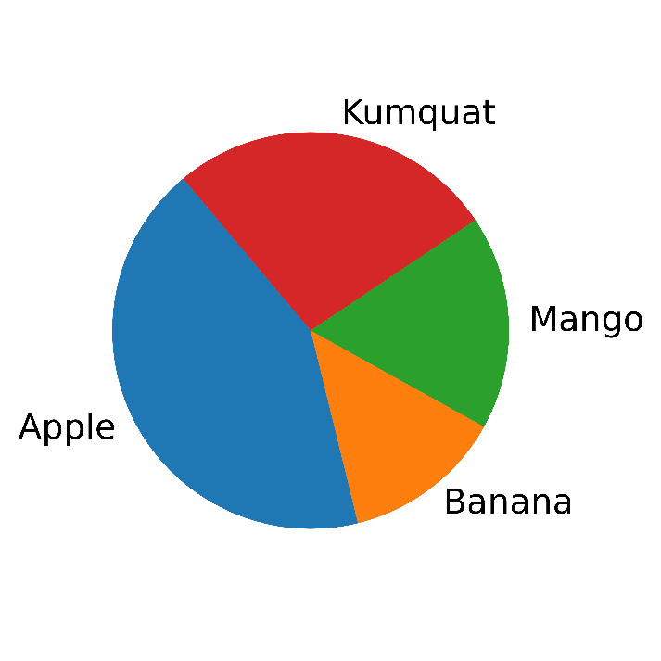
What makes a bad plot? Pie charts
Which pie chart represents the real data?
Are any the same?
Apples | Bananas | Mangos | Kumquats
80 | 30 | 40 | 50

Slide 11
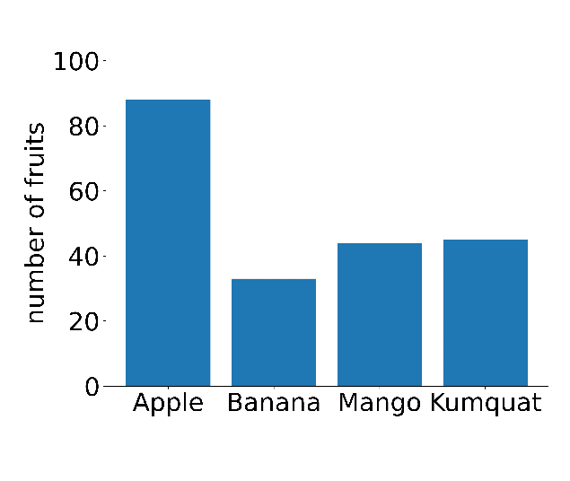
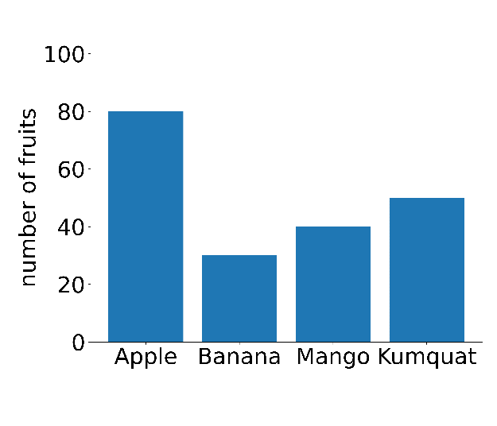
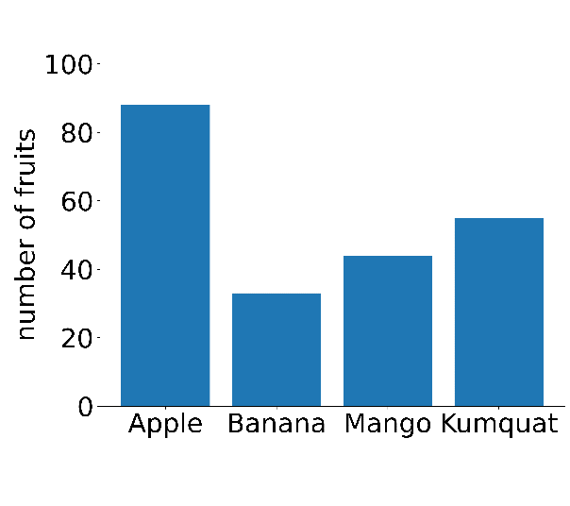
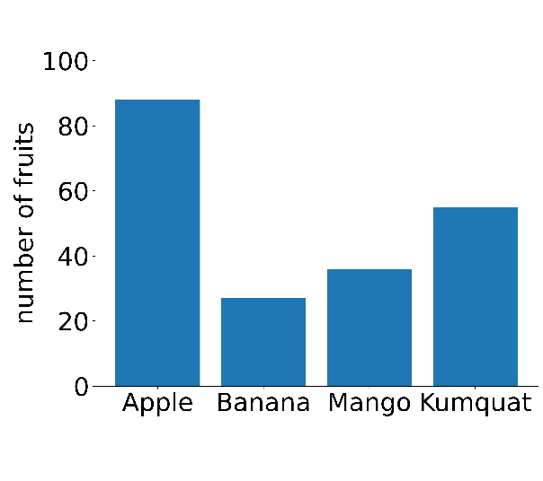
It is hard to compare areas of shapes
Apples | Bananas | Mangos | Kumquats
80 | 30 | 40 | 50

Slide 12
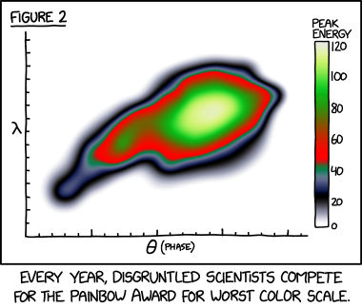
What makes a bad plot? Colour
https://xkcd.com/2537/

Slide 13
What is wrong with colour?
Colour can be a valuable component of a plot. However,
Colour can be misleading.
Colour can reduce accessibility of a plot.

Slide 14
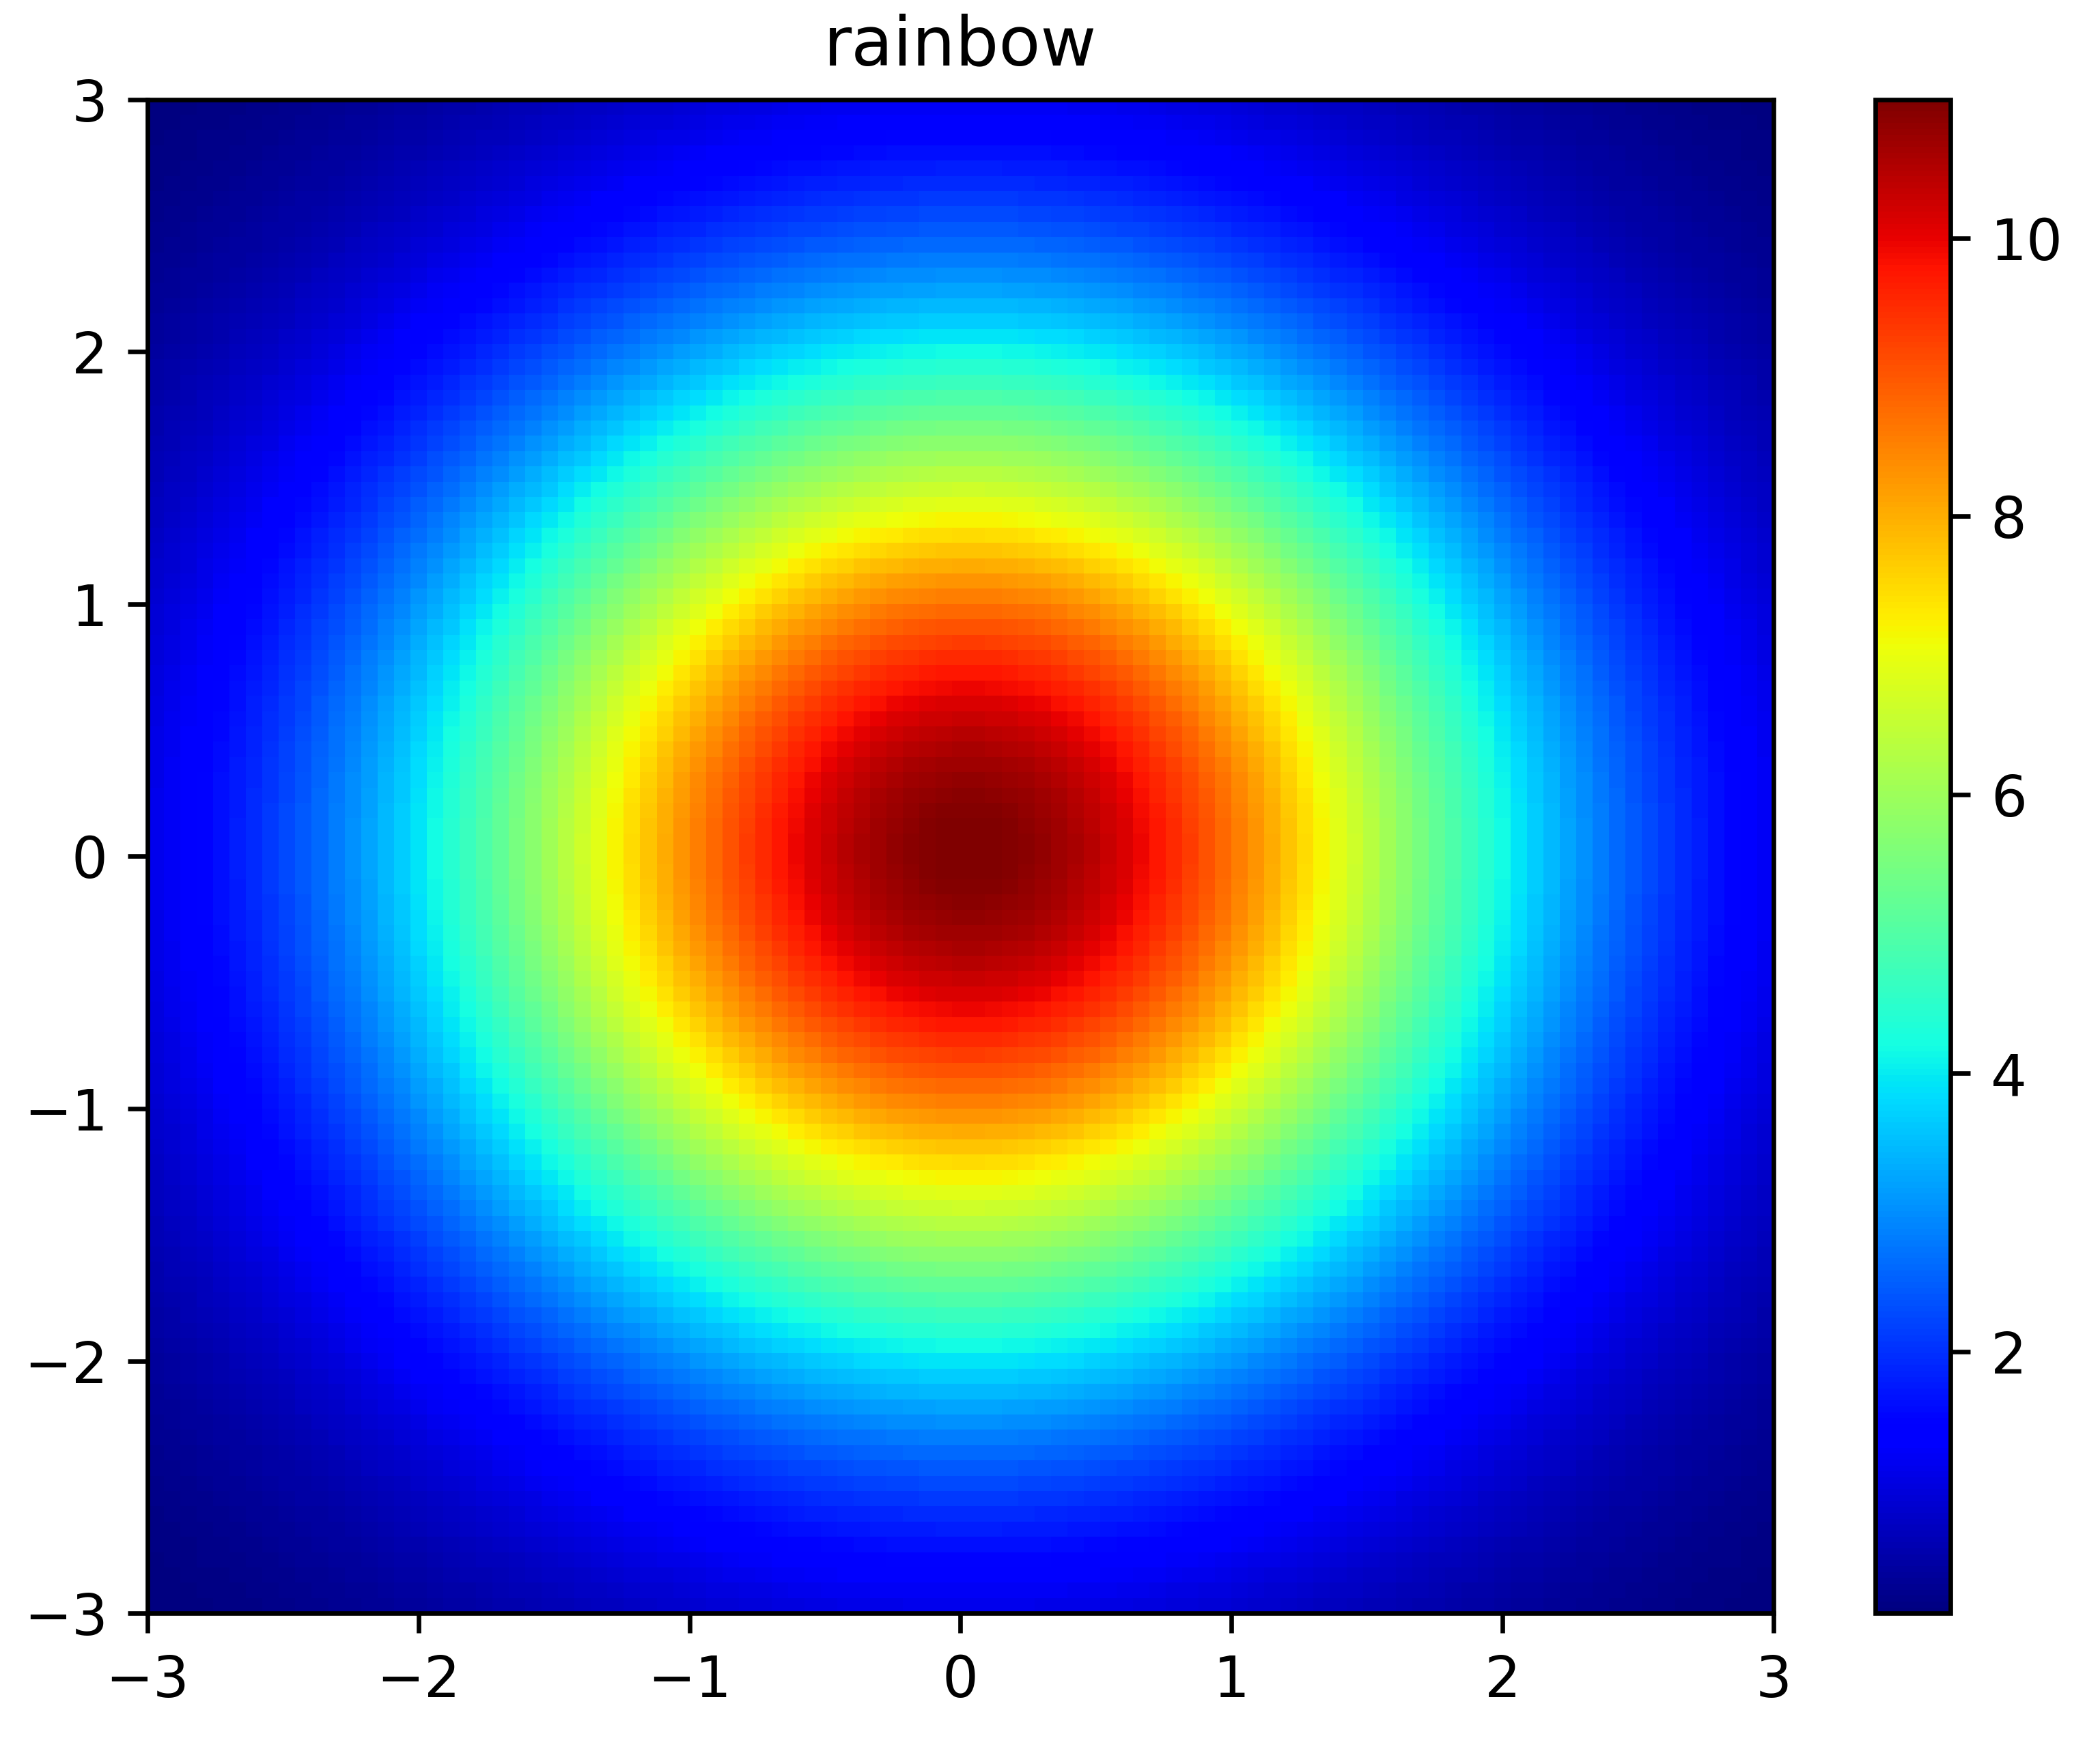
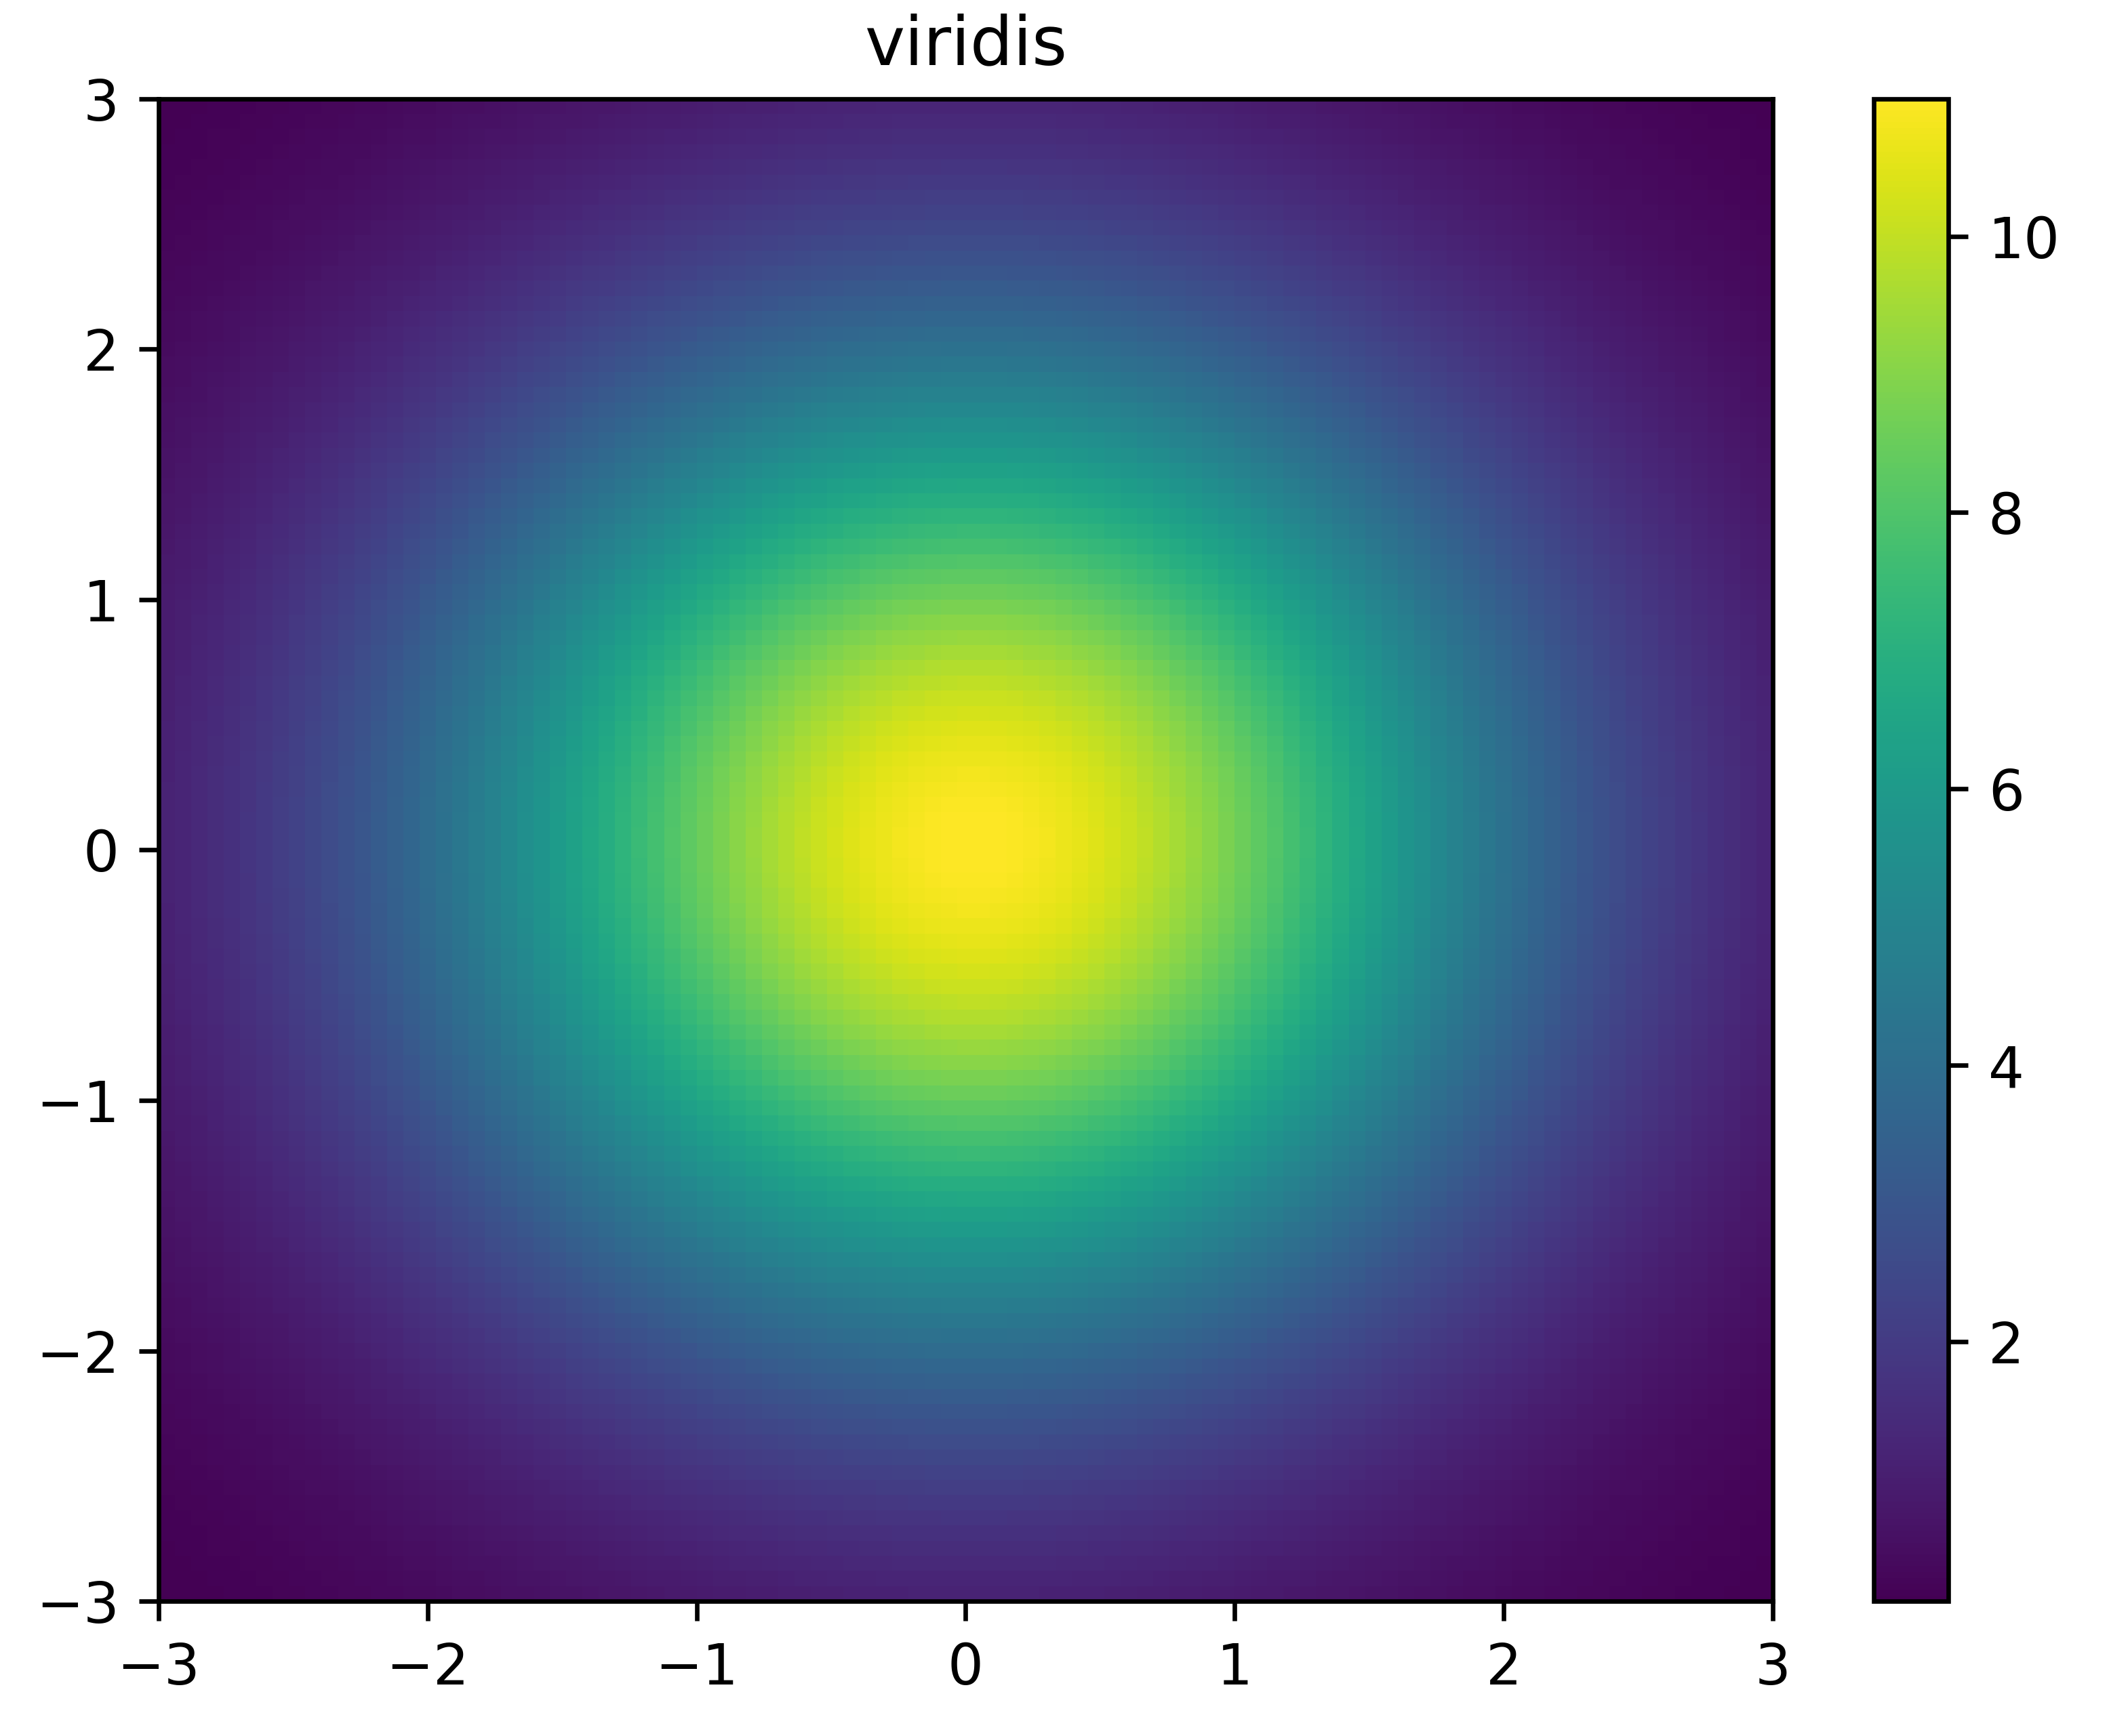
Colour should accurately represent data
Rainbow colour schemes have inconsistent brightness and apparent rate of change in colour
Perceptually uniform colour schemes like viridis have consistent change in brightness and colour throughout

Slide 15
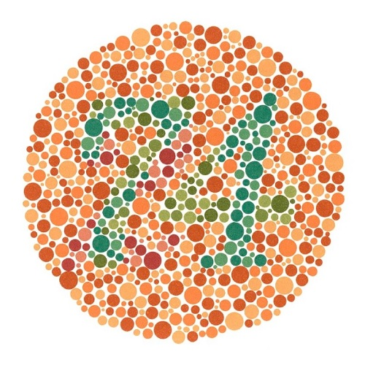
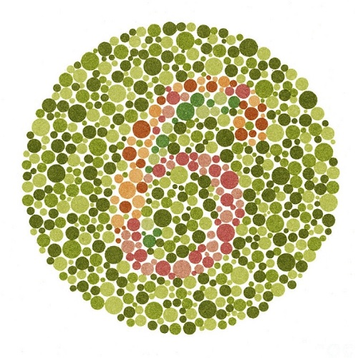
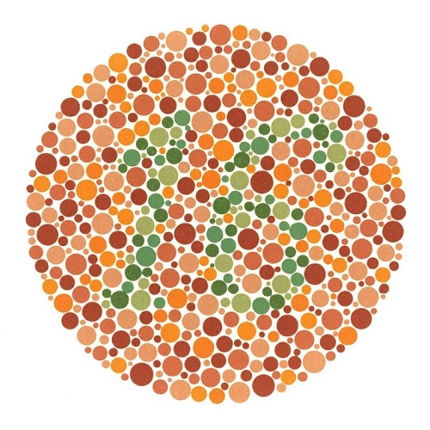
Around 8% of males and 1% of females are colourblind
74 or 21?
6 or 5?
16 or nothing?

Slide 16
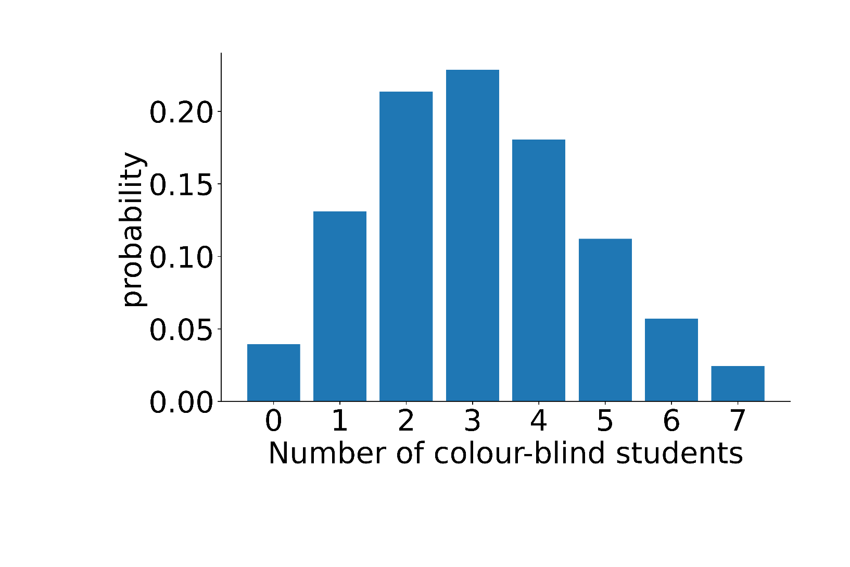
There is a 96% chance at least one of you is colourblind

Slide 17
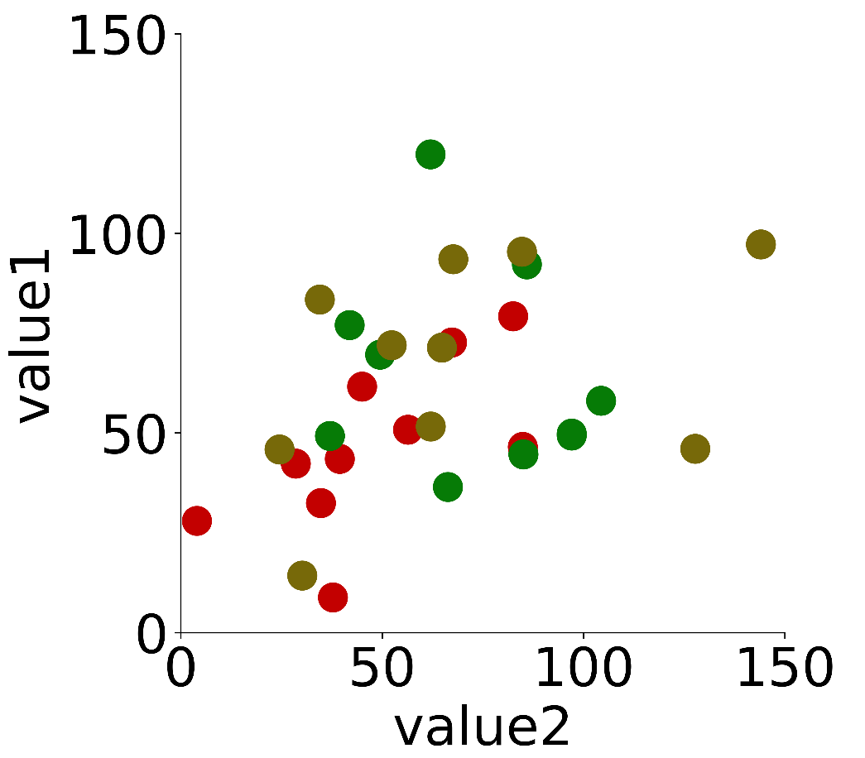
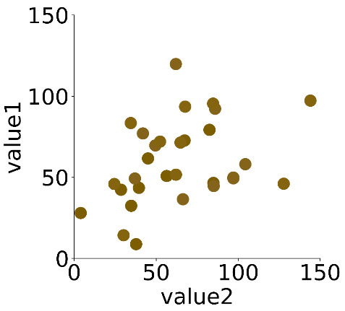
Low saturation colours and red with green should be avoided
An image using colours which do not offer good contrast to viewers with colour blindness
The same image with simulated colour blindness

Slide 18
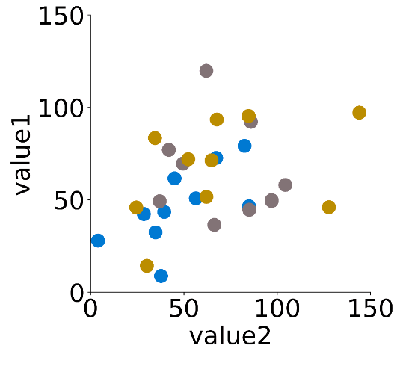
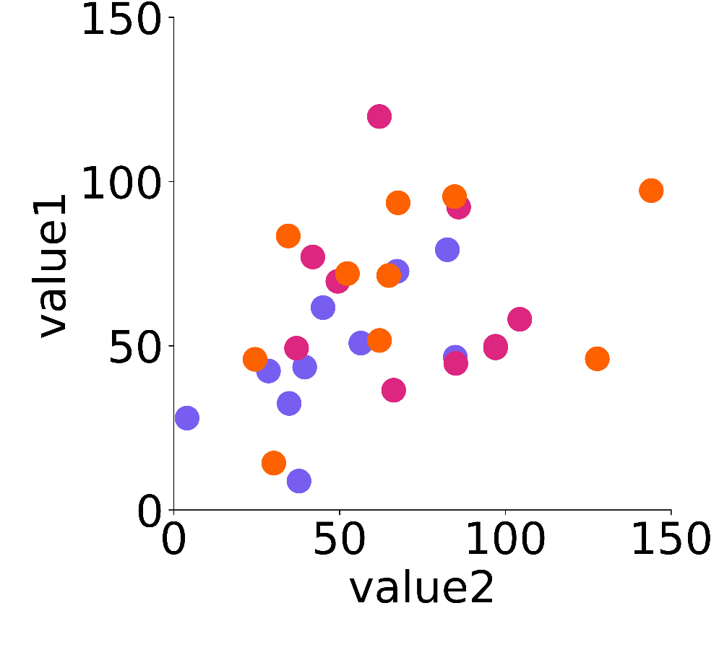
Many visually appealing colour schemes are clear to people with colour blindness
The same data plotted using colourblind-friendly colours
The same image with simulated colour blindness

Slide 19
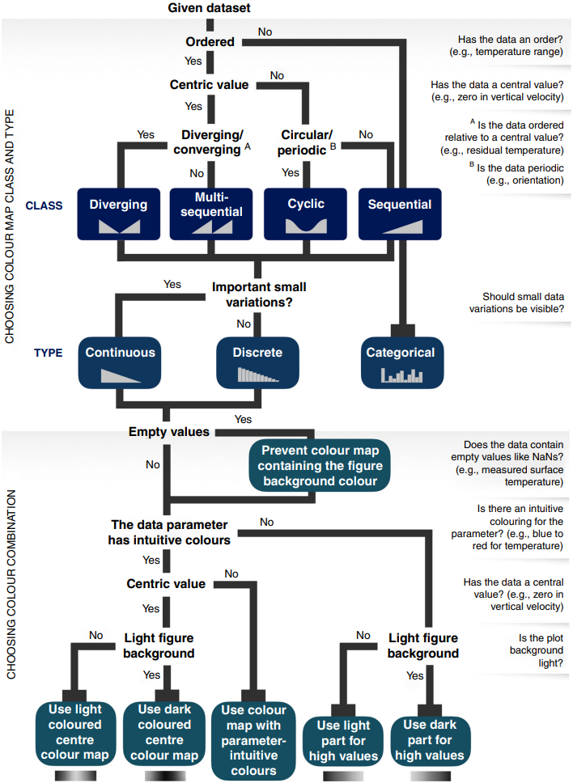
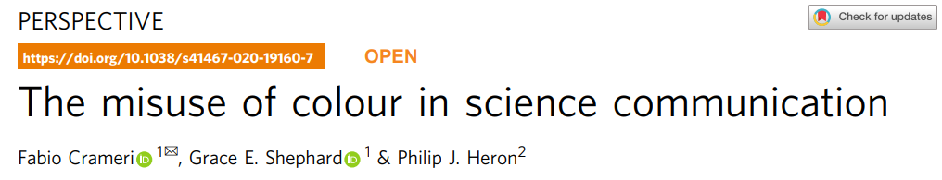
This week’s optional readings have lots of guidance for making effective plots

Slide 20
Useful resources for accessible visualizations
Simulate colour blindness on your screen https://colororacle.org/
Web tool to explore colour palettes with simulated colour vision deficiencies https://davidmathlogic.com/colorblind
Convert an image to simulated colour vision deficiency colour space https://www.color-blindness.com/coblis-color-blindness-simulator/
Recommended reading list

Slide 21
Plan for today
What is a plot?
Guidelines for creating effective plots
Plotting in Python
Intro to statistics
Statistics in Python

Slide 22
Plotting in python (matplotlib)
Must be installed (mamba install matplotlib)
Uses individual data, lists of data, or dicts of data
Also works with numpy arrays and pandas dataframes
Plots are composed of elements and layers
Elements include shapes (e.g., barplot bar) axes, ticks, labels
Layers contain plotted data (you can draw over plotted data)

Slide 23
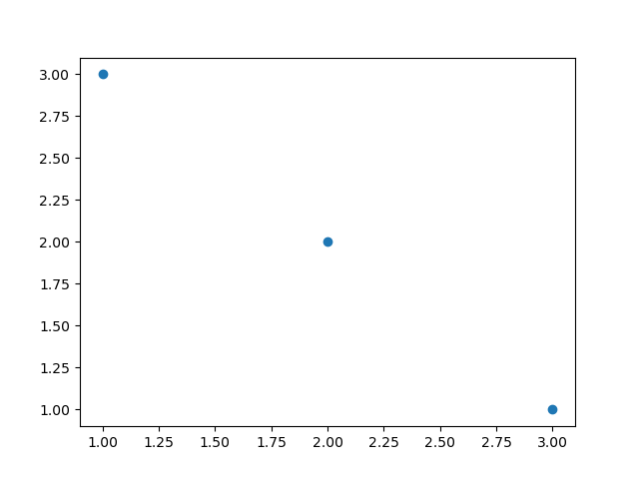
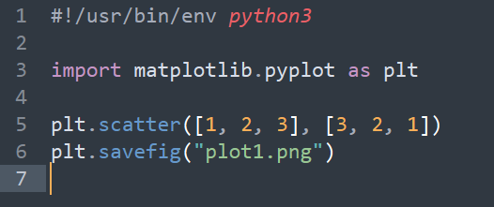
A basic plot involves matplotlib.pyplot class

Slide 24
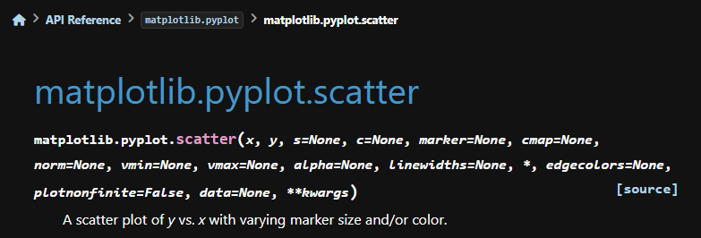
Each plot method supports control over appearance

Slide 25
Matplotlib has excellent tutorials
https://matplotlib.org/stable/tutorials/pyplot.html
https://matplotlib.org/stable/tutorials/lifecycle.html
Available as webpage, python script, or jupyter notebook

Slide 26
Plan for today
What is a plot?
Guidelines for creating effective plots
Plotting in Python
Intro to statistics
Statistics in Python

Slide 27
Statistics is a mathematical discipline concerned with analyzing data
Descriptive statistics – what do the data show about things we measured
Summary statistics: central tendency, spread
Inferential statistics – what do the data tell us about unmeasured things
Statistical inference
Hypothesis testing

Slide 28
Why use statistics?
Descriptive statistics
Quantify details about our data
Allows us to compare between datasets precisely
Allow us to communicate clearly about differences between datasets
Inferential statistics
Allow us to test hypotheses about whether distributions are different
Allow us to assign a confidence to conclusions
Are more reliable than our eyeballs in identifying

Slide 29
Plan for today
What is a plot?
Guidelines for creating effective plots
Plotting in Python
Intro to statistics
Statistics in Python

Slide 30
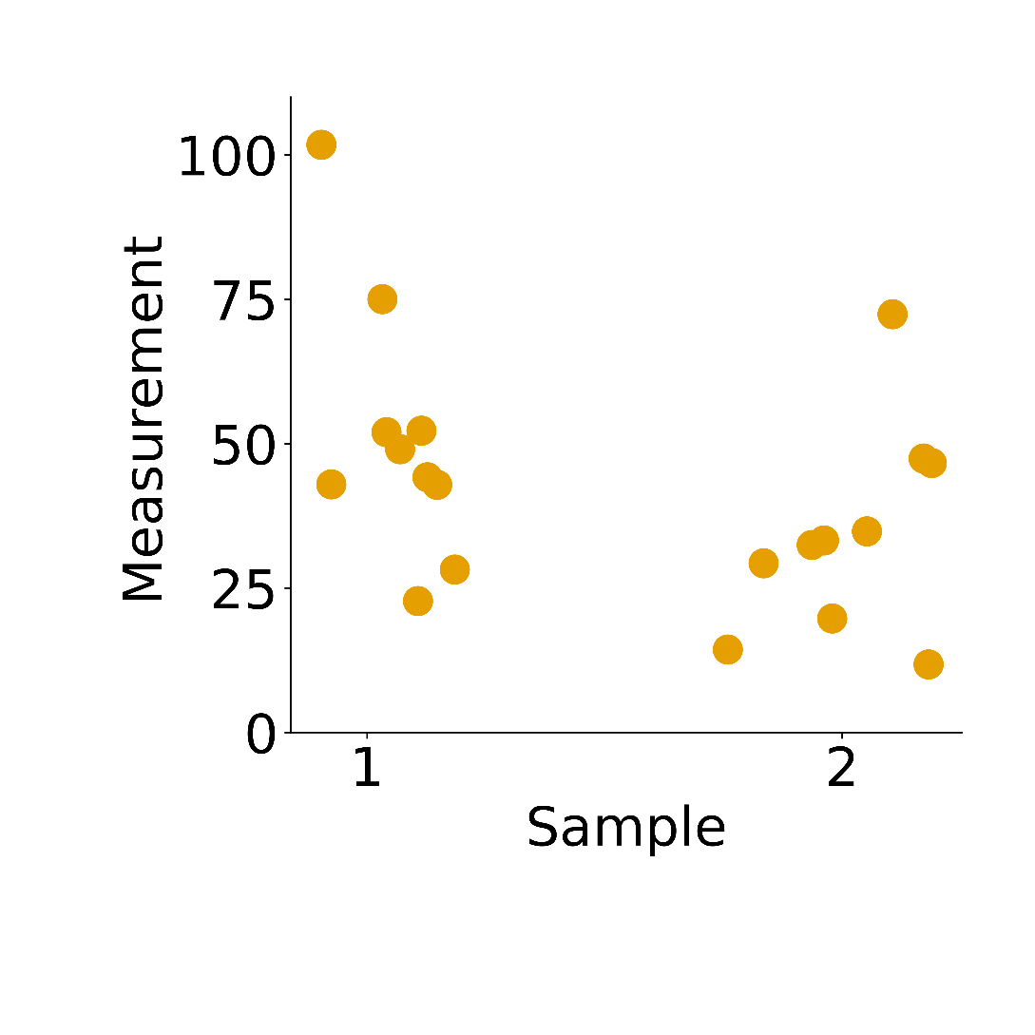
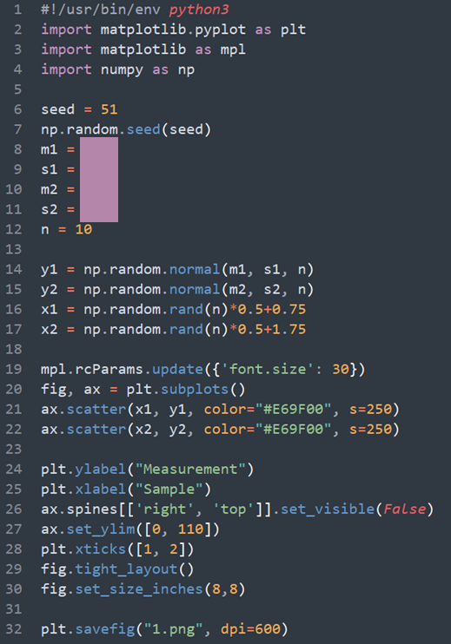
Are the data from sample 1 and sample 2 different?

Slide 31
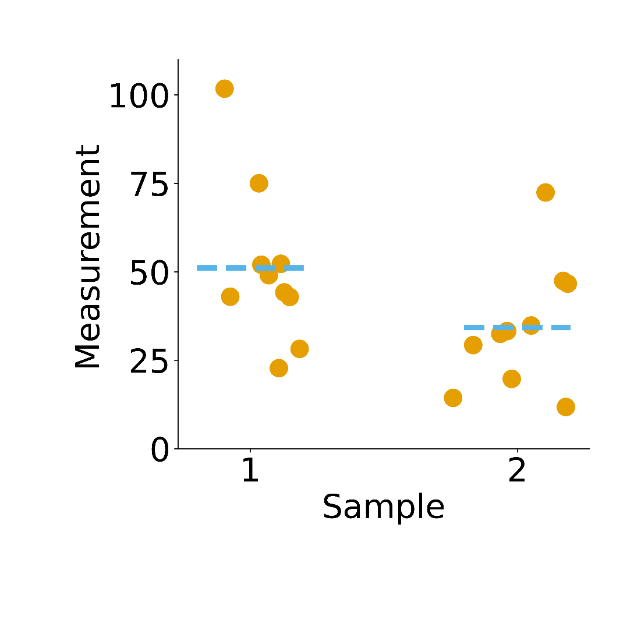
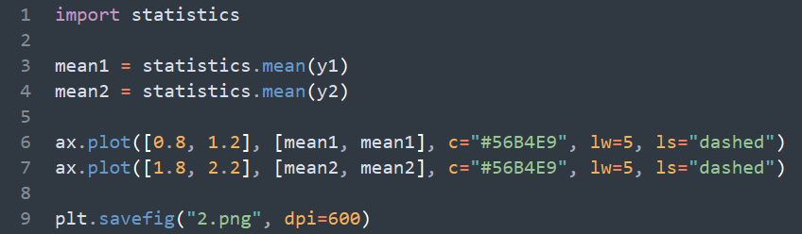
Describe central tendency – mean
mean1: 51.1, mean2: 34.2

Slide 32
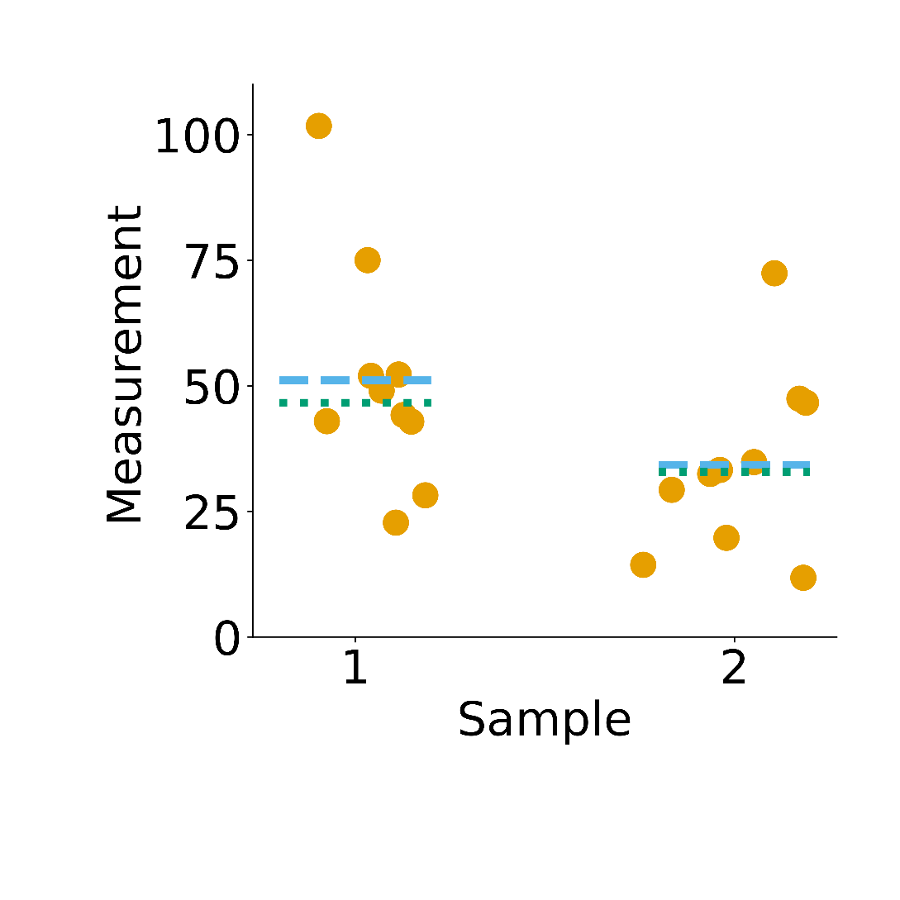
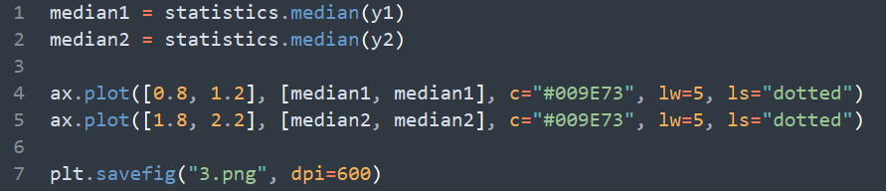
Describe central tendency – median
median1: 46.6, median2: 32.9

Slide 33
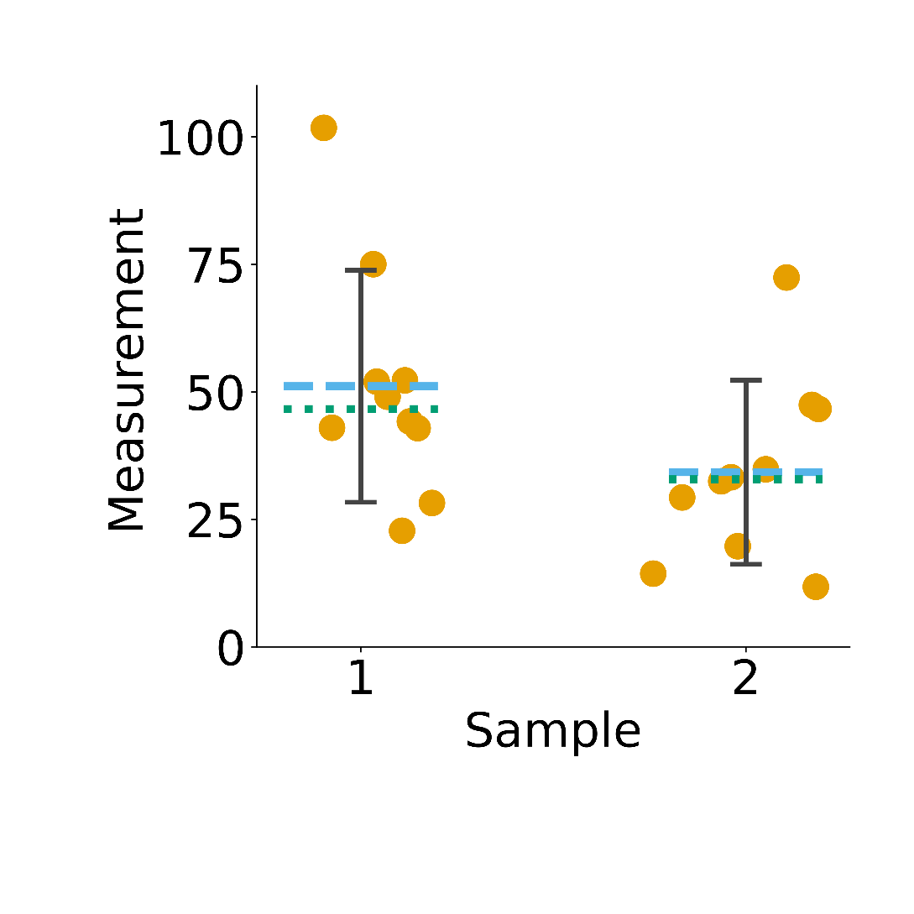
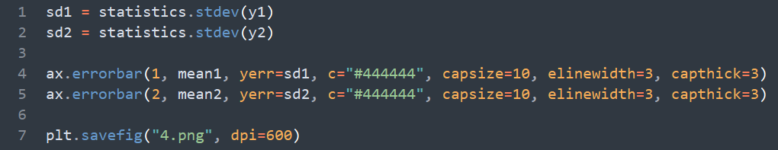
Describe spread – standard deviation
sd1: 22.7, sd2: 18.0

Slide 34
Are the data from sample 1 and sample 2 different?
Many statistical tests have been developed to test hypotheses about data
2 main classes with different assumptions about the distribution of your data
Parametric: normally distributed data
Non-parametric: do not assume normal distribution
Different tests have different assumptions about the data and test different hypotheses
Important to use appropriate tests and only make conclusions about the tested hypothesis

Slide 35
What test can we use?
Our data are normally distributed
We know because I generated them by sampling from a normal distribution
We could test this if we didn’t know e.g., Shapiro-Wilk’s test
Our hypothesis is that the two samples come from populations with different means
i.e., that one sample has a higher mean than the other
We are not testing a hypothesis about whether one sample is more variable
A t-test can be used in this case

Slide 36
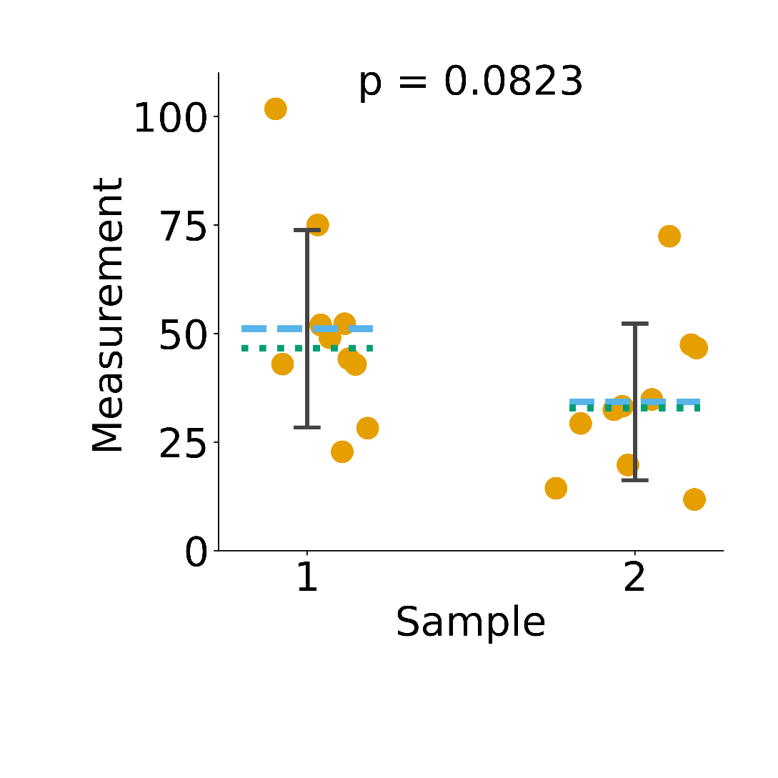
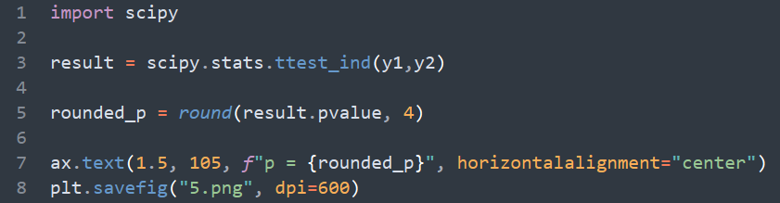
Are the data from sample 1 and sample 2 different?
Package “scipy” includes many stats tests.
e.g., https://docs.scipy.org/doc/scipy/reference/generated/scipy.stats.ttest_ind.html

Slide 37
Does p=0.08 mean the samples are different?
P value approximates the chance you would see a difference at least this big by chance if the samples were the same
P=0.08 means you’d see at least this big a difference about 8% of the time if you randomly sampled two datasets from the same population
Common cutoff is p <= 0.05 to reject the null hypothesis that the two samples have the same mean
This doesn’t meet the p <= 0.05 cutoff, so it’s settled, right?

Slide 38
P <= 0.05 isn’t a magic threshold
P <= 0.05 expected to occur by chance 1/20 times if sampling the same population
You could equally accept p <= 0.1 if that rate of error is acceptable
Better to focus on biological importance of difference
P value more of a guide of whether you would expect to see the difference if you repeated the experiment
P values are controversial
https://www.tandfonline.com/toc/utas20/73/sup1 (especially the editorial)
recommended readings

Slide 39
The original conception of the p value was not as one shot proof of an effect – requires replication
“Personally, the writer prefers to set a low standard of significance at the 5 percent point . . . . A scientific fact should be regarded as experimentally established only if a properly designed experiment rarely fails to give this level of significance.”
Fisher RA: Statistical Methods for Research Workers. Oxofrd, UK, Oxford University Press, 1958

Slide 40
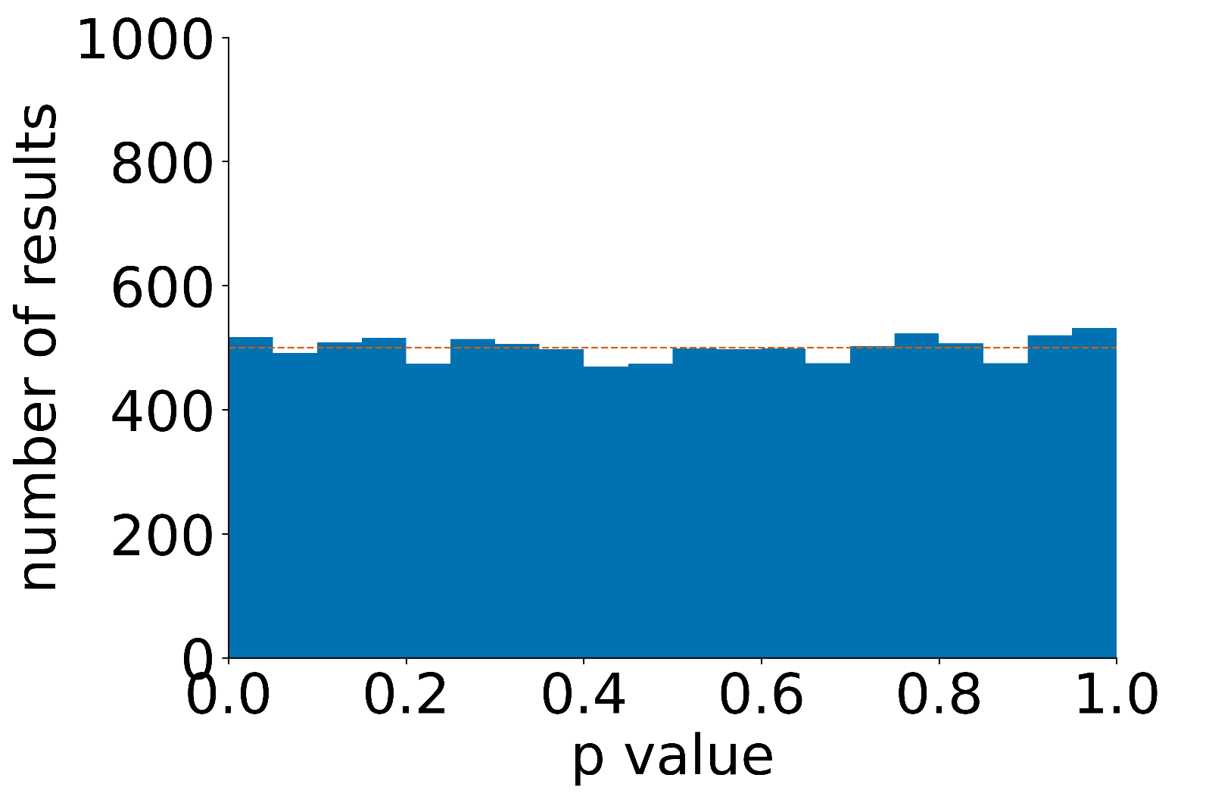
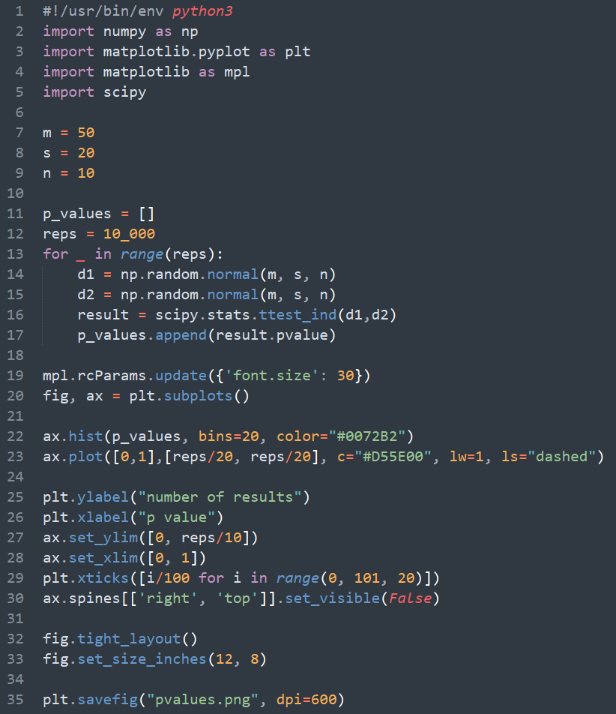
If you randomly sample the same distribution, you get p<0.05 about 5% of the time

Slide 41
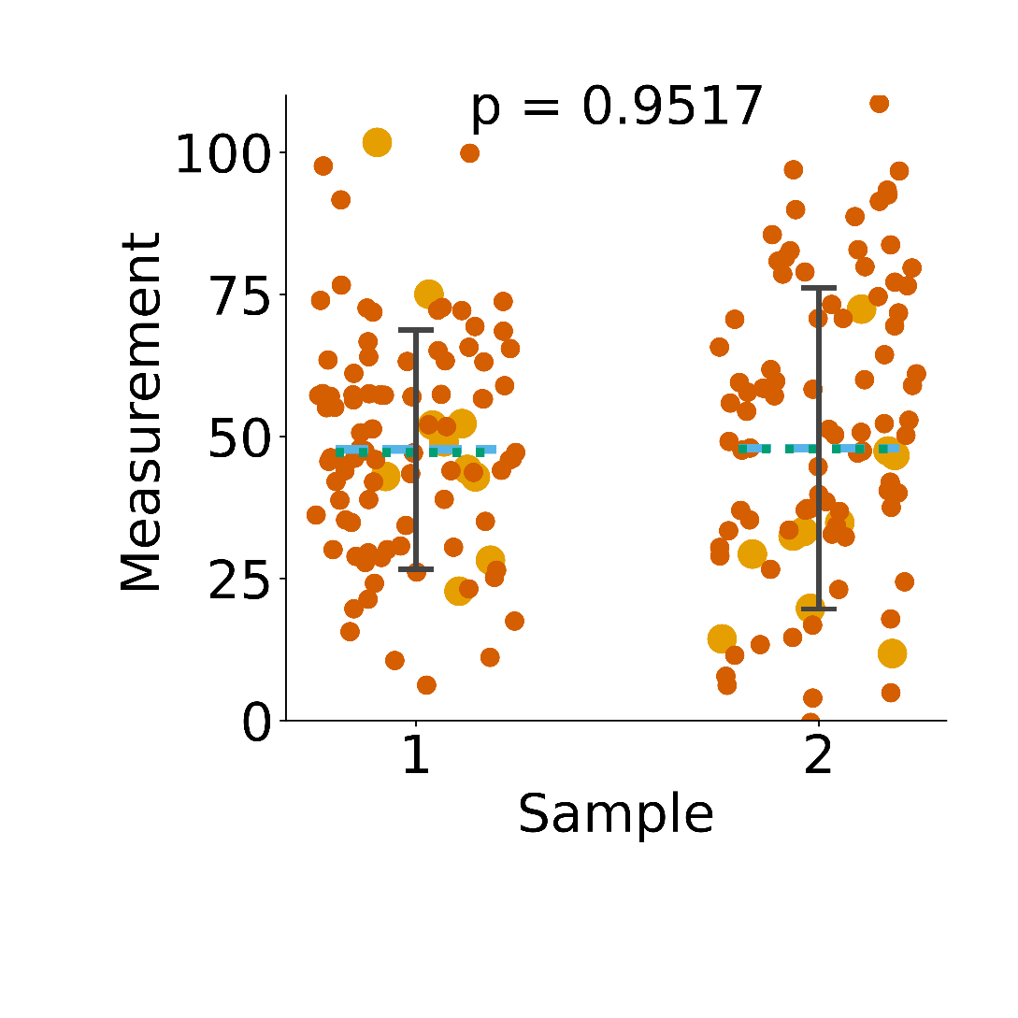
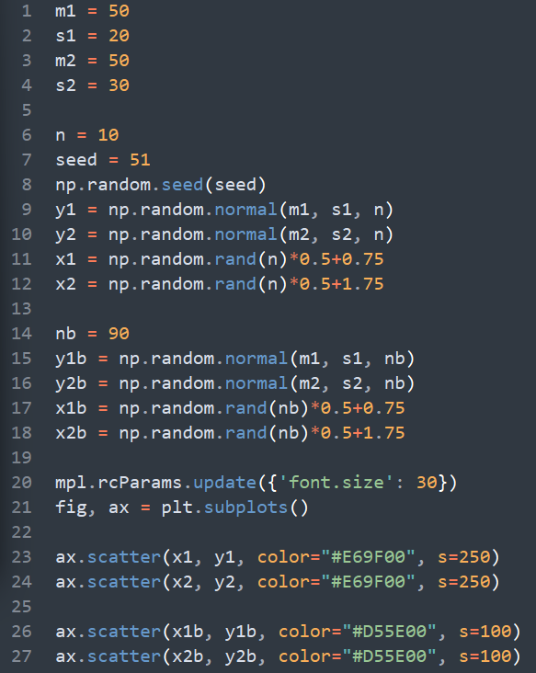
What about our sample with p= 0.08? True mean is the same

Slide 42
End of Lesson

